Slide 1
Dimensionality Reduction on Lending Club dataset with Support Vector Classifier (SVC)
By Sai Nikhil Gundu (800962726)

Slide 2
Agenda
Problem in hand and solutions
Principal component analysis
Support vector classifier
Code walk-though
Results and future scope

Slide 3
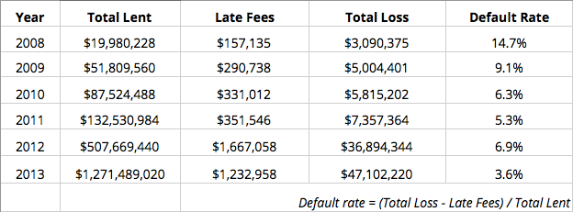
Problem in hand and Solutions
Default rate prediction: Given the other factors, can we predict the default rate ?
Why prediction : For the lossless decisions on the loan approvals
Solutions:
Fit a model to the dataset (a robust classifier), to predict the default
Source: http://www.lendingmemo.com/lending-club-prosper-default-rates/

Slide 4
Let’s proceed with modeling
Data cleaning procedure as discussed in the classroom
Imputing missing values
Dummy variable creation (For categorical to numeric)
Pickling the dataset-Serialization in python (data pickled periodically for the ease of coding)
Model building Concept
Let us create a trainer model class (for iterative purposes)-Object Oriented approach
Everything that a model is expected to do has been written as def (functions/methods)-similar to java
Ease of using the code (Eg: Initialize a class and perform the required function exclusively)
Parameters to the model can be set dynamically, no need to alter the base code
Methods used:
Principal Component Analysis for dimensionality reduction
Support Vector Classifier (SVC), to include the effect on trainer

Slide 5
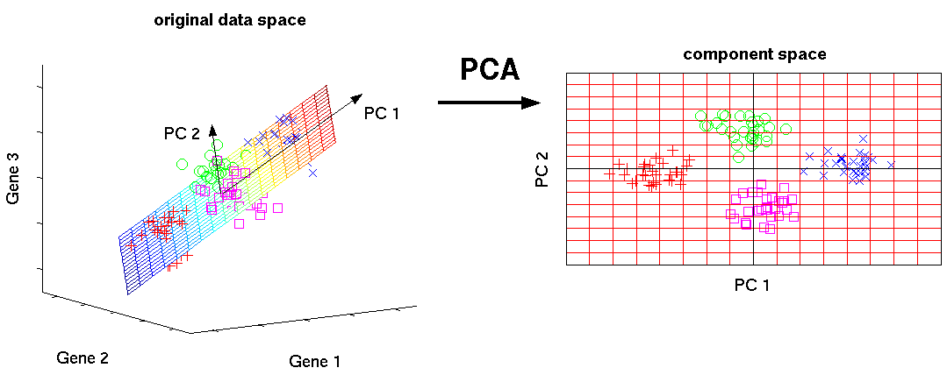
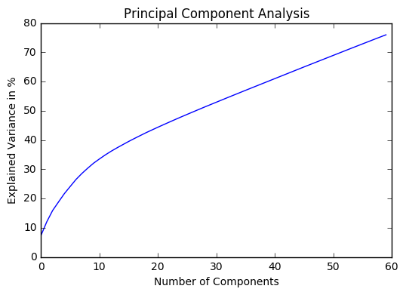
Principal Component Analysis
Most of the variables are correlated
Running a model on whole data returns poor accuracy
Strategic method to find few important variables
How many PCS to choose?
Check for the explained variance vs. variable plot
Number of variables taking most of the variance into account has to be chosen
In this case, 50 is chosen initially
Source:nlpca

Slide 6
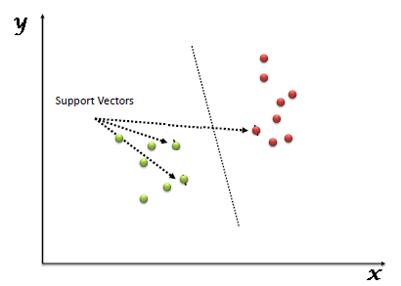
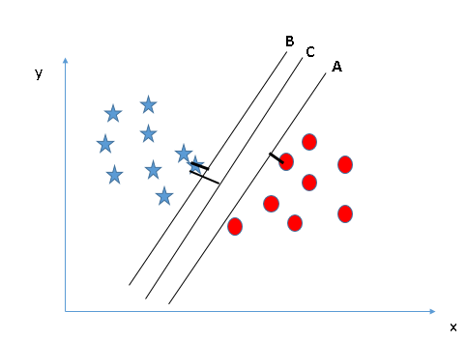
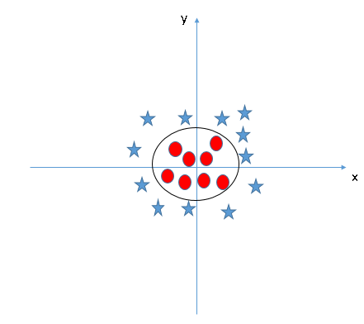
Support Vector Classifier
Best segregates the two classes (hyperplane/ line)
To identifying the right hyperplane-check margin
kernel- These are functions which takes low dimensional input space and transform it to a higher dimensional space i.e. it converts not separable problem to separable problem
Tuning SVM
Grid Search SVM for parameters, C(0.1,0.01,..) and gamma(Ex: 1,10,..)
Even kernel can be included fro grid search (Eg. rbf, linear)
In this case, linear kernel is used for simplicity
Source: understanding-support-vector-machine

Slide 7
Code: Walk-through
Data Cleaning
Creating dummies
Missing values
PCA
Initial PCA on training set
Retain the optimum num_variables
Trainer Class
Write methods for various computations
Include PCA as a method-generalized model
Pickling the data
SVC defined as a method
Initialize trainer and run the methods

Slide 8
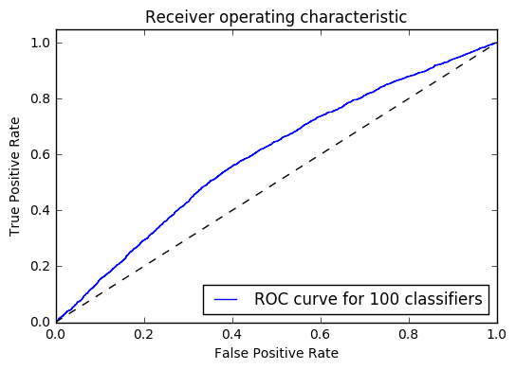
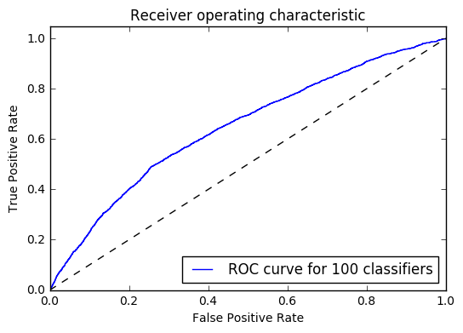



Results
without PCA
With PCA
Training Scores:
Training Scores:
Test Scores:
Test Scores:

Slide 9
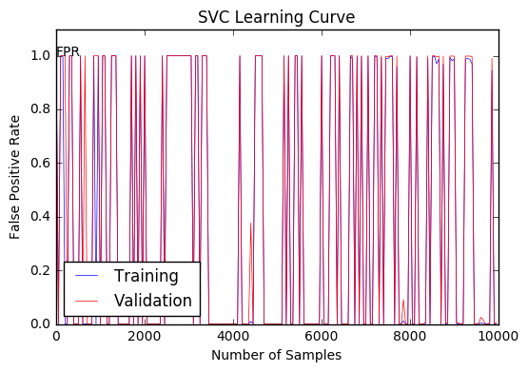
Results
SVC Learning Curve on Train and Validation sets

Slide 10
Future Work
Running Grid Search on SVC for better fits
Varying the num_variables of PCA in [50:80]
Include various other classifiers as methods of the trainer class to compare the models
“The 2nd time it’s a mistake, the 1st time is a learning opportunity..”
-Thank You

Slide 11
Thank You!

Slide 12
Back up

Slide 13
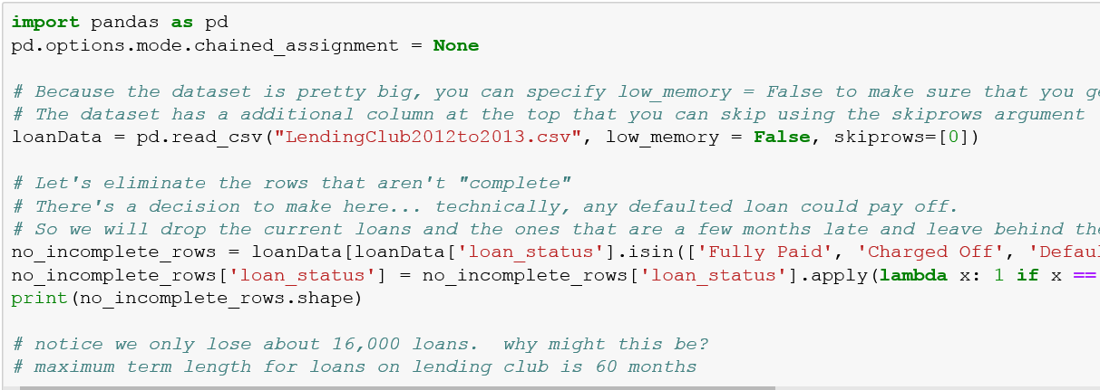
Back up Code: Data Cleaning

Slide 14
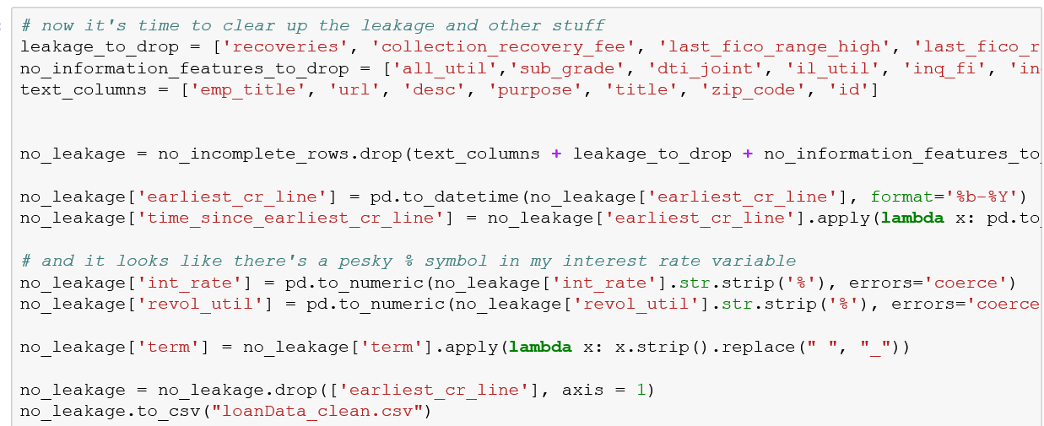
Back up Code: Data Cleaning

Slide 15
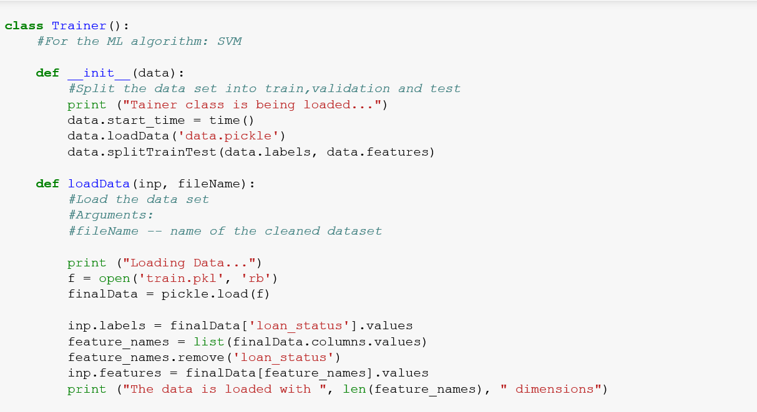
Back up Code: Modeling

Slide 16
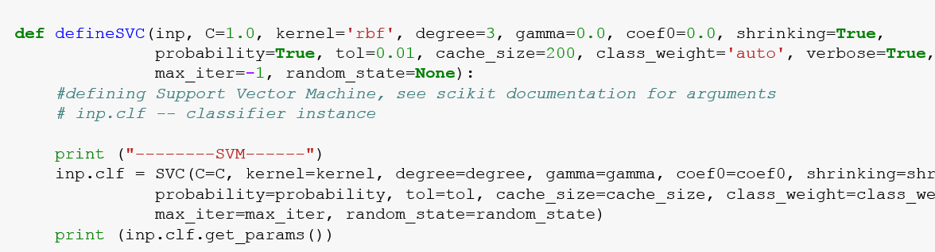
Back up Code: Modeling

Slide 17
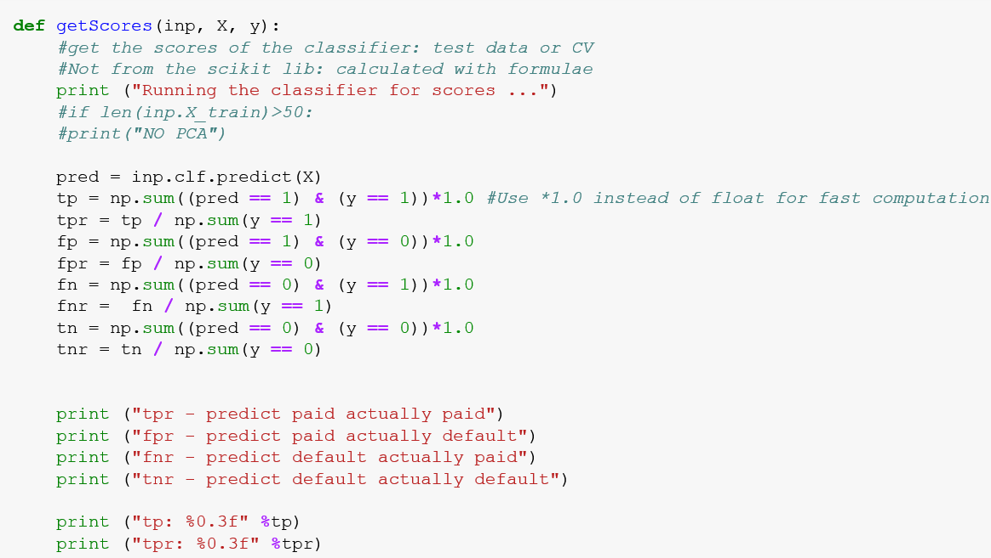
Back up Code: Modeling

Slide 18
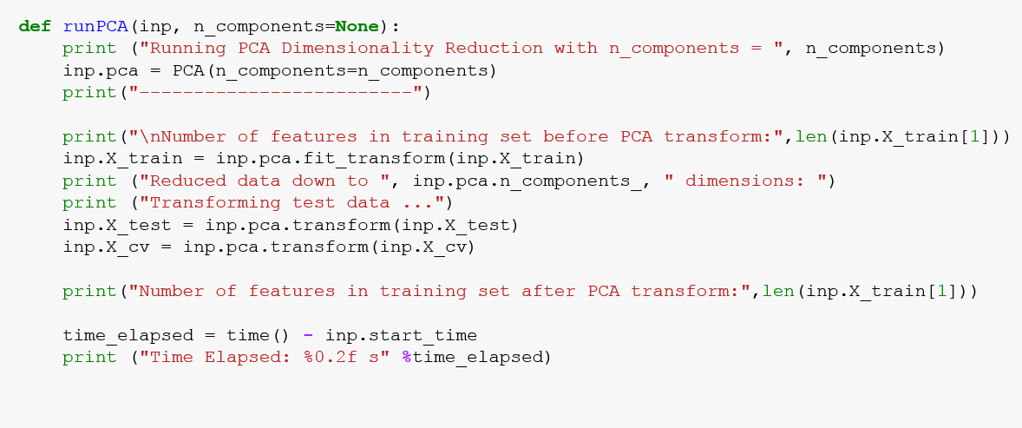
Back up Code: Modeling

